Slide 1




Astronomy 1010 chapter 25
Clayton State University
Slides for Astronomy textbook from OpenStax
https://openstax.org/books/astronomy/

Slide 2
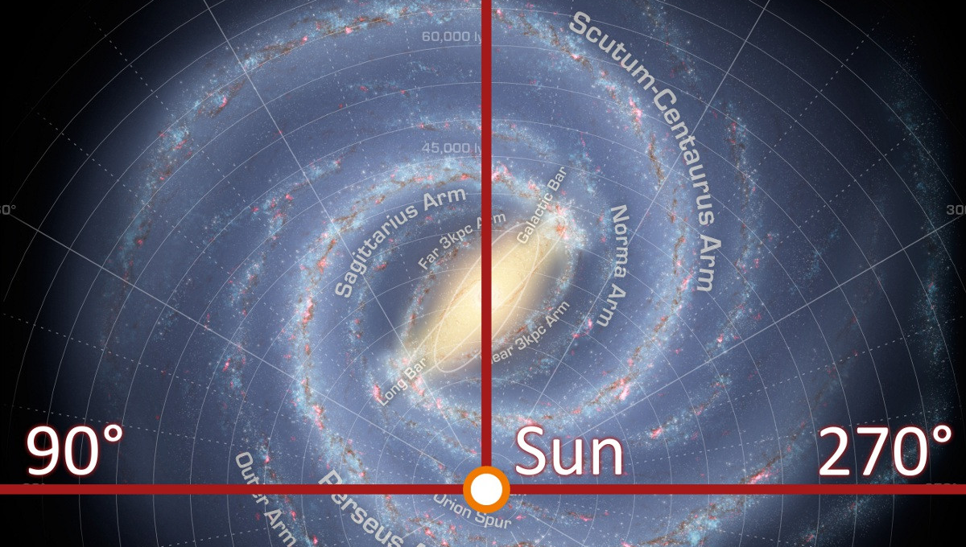
Our Galaxy – Milky Way

Slide 3

Our galaxy – intro https://www.youtube.com/watch?v=tj_QPnO8vpQ

Slide 4
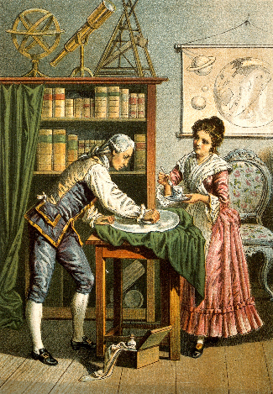
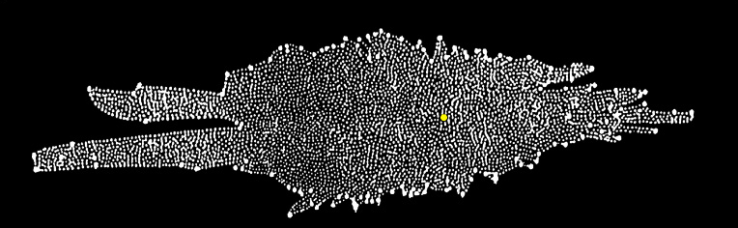
Galactic Astronomy
1785 - Herschel attempted to determine the shape and size of Galaxy
  Assumptions:
    All stars have same intrinsic brightness
    Star are arranged uniformly throughout the galaxy
    He could see to the edge of the galaxy
SUN
Herschel could not account well for the effects of dust.
Lots of dust along the disk causes the distribution of stars to drop-off – objects more than a few kiloparsec from the Sun are obscured by dust.

Slide 5
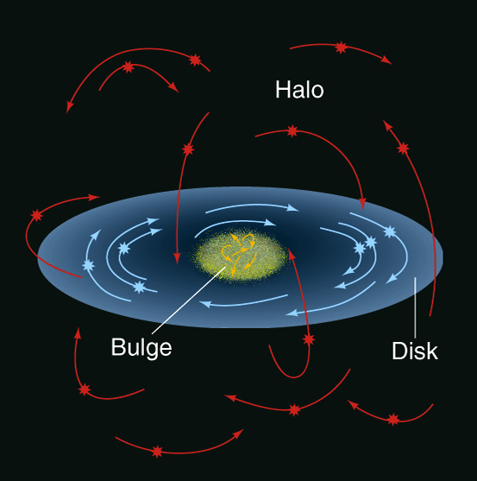
Morphology of our Galaxy
In the early 1900’s, the first kinematic studies of the MW revealed the velocities of globular clusters (clusters of stars outside the galaxy disk) were ~250 km/s, much higher than the mass of the galaxy model would require. So, the galaxy must contain more stars (and mass) than originally thought in order to keep the star clusters from flying off.
First detailed kinematic model (Lindblad 1927) revealed
A spherical component with random motions (~250 km/s) → HALO
A flattened component with rotational motion measured at 200 to 300 km/s near the Sun – DISK
A third component, also spherical, exists in the center of the galaxy – BULGE
  Stars here move on mostly random orbits

Slide 6
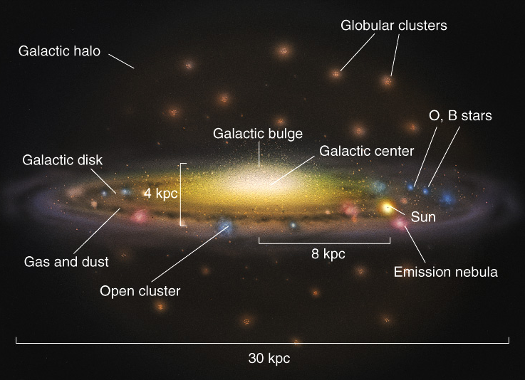
Morphology of our Galaxy -2
The three components of our galaxy (disk, halo and bulge) also differ in the mix of the types of stars they contain
  Population I: Hot, blue stars and young open clusters accompanied by gas and dust are primarily found in the disk of the Milky Way
  Population II: red stars and older globular clusters are found in the halo of the Milky Way

Slide 7
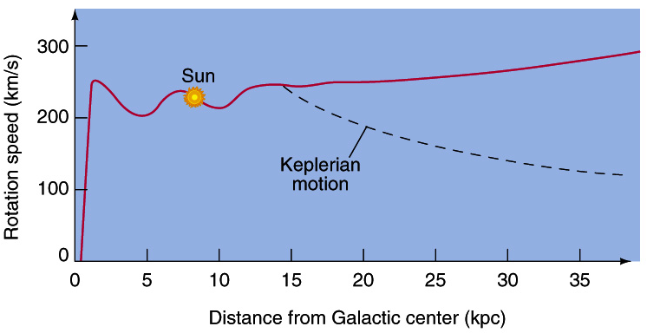
Rotation Curve – orbital speeds of the stars
Since the Milky Way rotation curve shows no drop in velocities beyond the galactic bulge, and even within the disk disk (around R=15 kpc as expected by models), this indicates the presence of some additional, non-luminous material that was later called the Dark Matter
Even though Dark Matter is detected gravitationally through measurements of the orbital speeds in the Galactic Disk, it is not necessarily confined to the disk and is likely to be distributed throughout the Galactic Halo. Most galaxies appear to exist within these Dark Matter Halos.

Slide 8
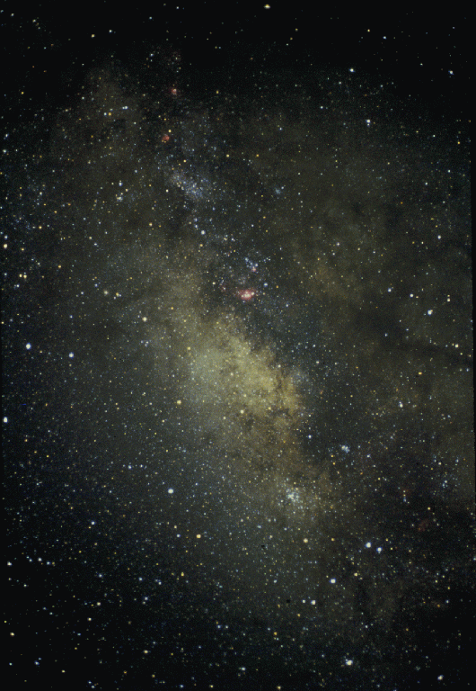
The Galactic Nucleus
Inner 500pc of Galaxy
Extinction makes optical studies impossible - use radio or IR
Observe ionized gas, line emission, dust, star clusters
Stellar density is 10⁷ stars per pc³ (compared to 0.1 in the solar neighborhood)
If the Sun were near the GC
  Nearest star would be ONLY 1000AU away
  A million stars brighter than Sirius in the night sky
  Total starlight more than 200 times brightness of the full Moon

Slide 9
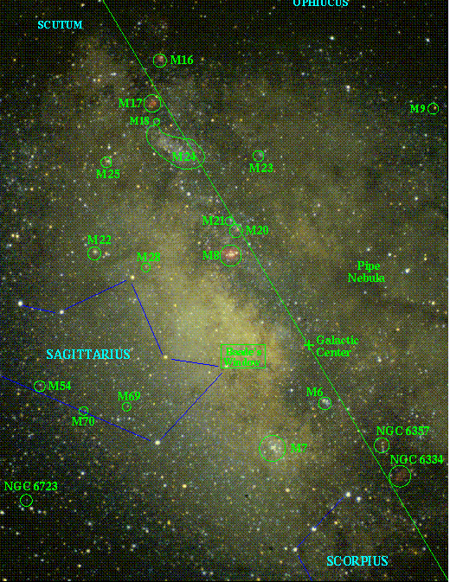
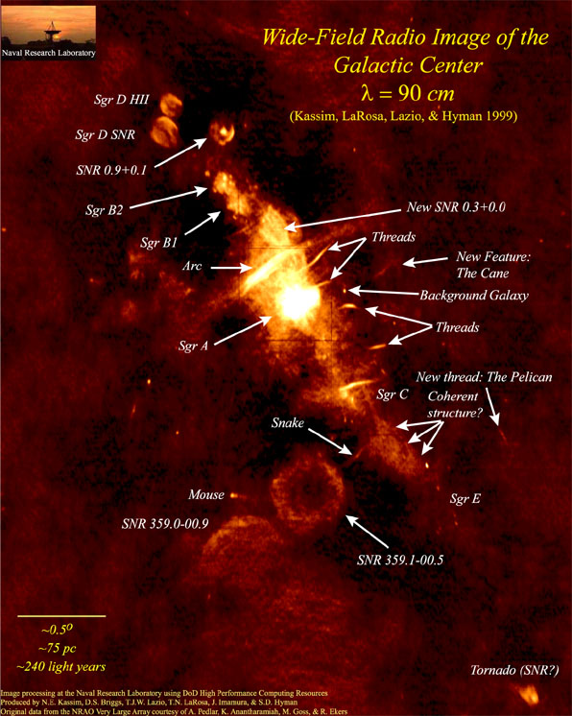
The Galactic Center
Optical vs Radio observations

Slide 10
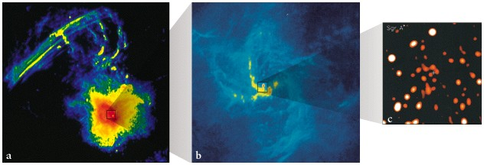
Supermassive Black Hole in the Galactic Center
Radio image (80 pc across) shows feature SgrA (Sagittarius star A) and radio filaments
Radio image (10 pc across) shows feature known as SgrA West – center of this is SgrA*
Investigate IR stellar motions in region about 1pc across (a few lightyears) to estimate BH mass
Notes:
SgrA* is only 6AU in diameter – would fit inside the orbit of Jupiter and is smaller than Betelgeuse

Slide 11
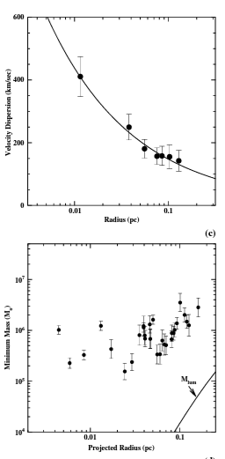
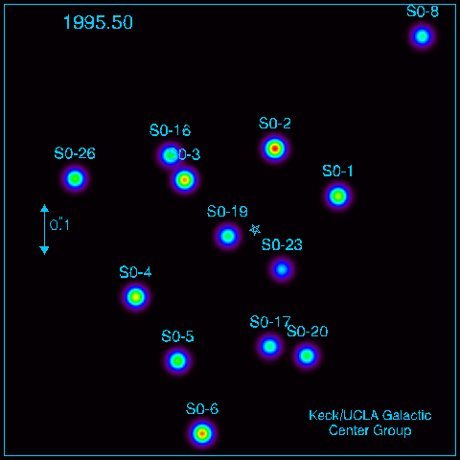
Measure proper motions of stars around Galactic Center
Adaptive optics at large telescopes improved ground-based resolution to 0.5” in IR (stellar positions measured to 0.002”)
90 stars identified and proper motions (largest at 1400 km/s!) centered about SgrA* to within 0.1”
Velocities consistent with Keplarian motion (all mass at center)
M = 2.6 +/- 0.2 x 10⁶ M_{sun}
Notes:
Would stars be tidally ripped apart before entering a BH of this mass? In our homework, we found that a person would not be tidally ripped for BH mass greater than 2000. But for stars (larger and more gaseous than people), they would be ripped apart before falling into the BH. This is what produces the X-ray light we discuss in the next slide.

Slide 12
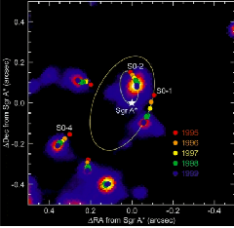
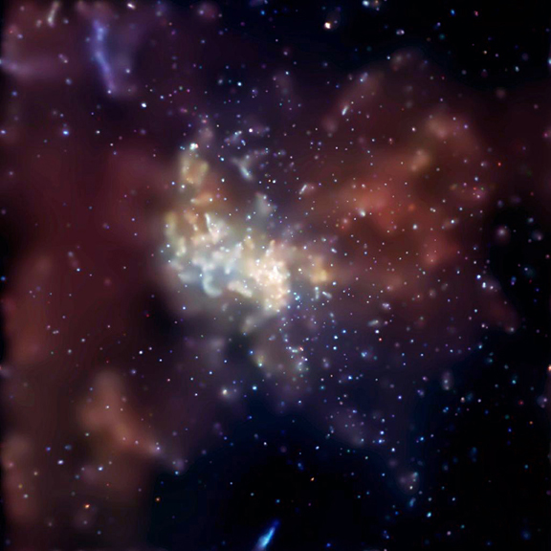
Curvature of the paths near SgrA* constrain the volume of the mass to ~ Schwarzschild radius (few x 10⁶ km) → Supermassive Black Hole
Additional evidence - X-ray emission
Chandra telescope X-ray image of Sgr A* showing nucleus and several thousand other X-ray sources.
During 2-week observation period, several X-ray flares occurred.
Rapidity of flares indicates they originate near the Schwarzschild radius of the BH.
Even during the flares, X-ray emission from the nucleus is relatively weak. Suggests that Sgr A* is a starved black hole, possibly because explosive events in the past have cleared much of the gas from around it.

Slide 13
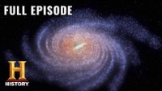
Milky Way galaxy – long video https://www.youtube.com/watch?v=-1VV2nh8GtE

Slide 14
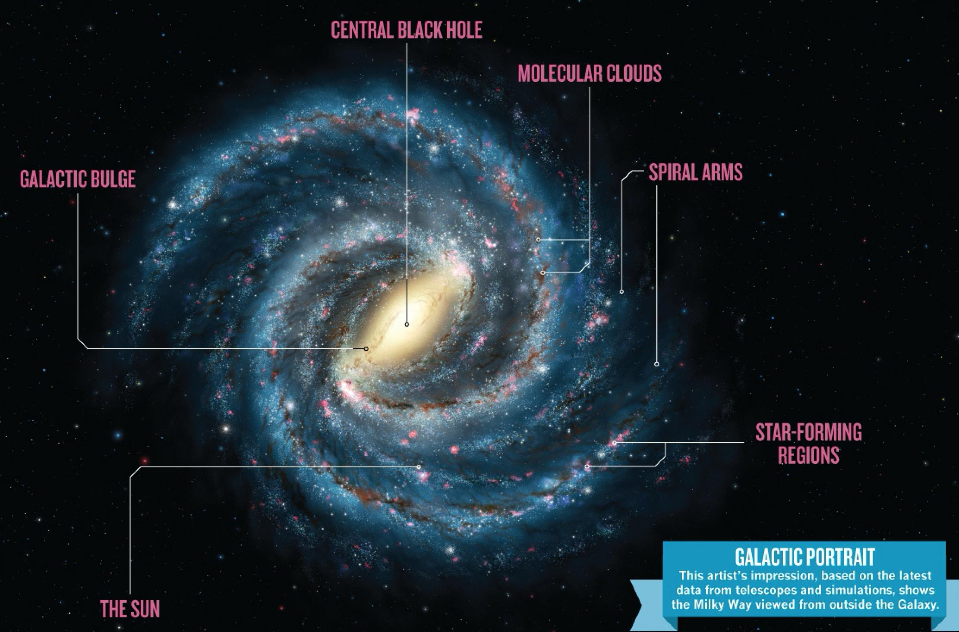
Any Questions?
Milky Way galaxy - reconstruction

